Slide 1
image © Warner Brothers

Slide 2
God
Genesis 3.8-13
Man
Family
Creation

Slide 3
one God, always existing, powerful enough to create the universe to be pure and useful simply by speaking
God
Man
Family
Creation

Slide 4
one God, always existing, powerful enough to create the universe to be pure and useful simply by speaking
God
people created in God’s image, to reflect God’s character, represent God, reproduce God’s image, and rule creation in God’s name
Man
Family
Creation

Slide 5
God
Spiritual
Blessing
Trust
?
?
?
?
?
?
Submit / Obey
Depend / Trust
?
?
?
YOU
Physical Blessing
Make YOUR own choices

Slide 6
Genesis 3.8 NIV: Then the man and his wife heard the sound of the LORD God as he was walking in the garden in the cool of the day, and they hid from the LORD God among the trees of the garden.
artwork by Grete Bauder

Slide 7
Genesis 3.9 NIV: But the LORD God called to the man,
“Where are you?”
artwork by Grete Bauder

Slide 8
Genesis 3.10 NIV: He answered, “I heard you in the garden, and
I was afraid because I was naked; so I hid.”
photo from Bible-Daily.org

Slide 9
Genesis 3.11 NIV: And he said, “Who told you that you were naked? Have you eaten from the tree that I commanded you not to eat from?”
God
Spiritual
Blessing
Trust
?
?
?
?
?
?
Submit / Obey
Depend / Trust
?
?
?
YOU
Physical Blessing
Make YOUR own choices

Slide 10
Genesis 3.11 NIV: And he said, “Who told you that you were naked? Have you eaten from the tree that I commanded you not to eat from?”
1 John 1.9 NIV: If we confess our sins, he is faithful and just and will forgive us our sins and purify us from all unrighteousness.

Slide 11
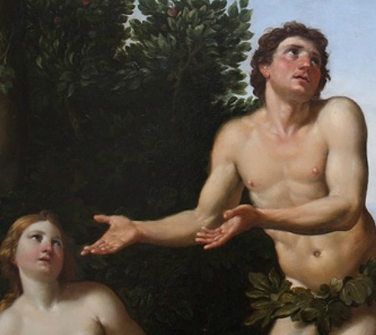
Genesis 3.12 NIV: The man said, “The woman you put here with me—she gave me some fruit from the tree, and I ate it.”
image from
psychologytoday.com

Slide 12
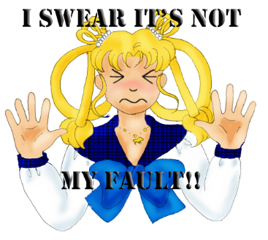
Genesis 3.13 NIV: Then the LORD God said to the woman, “What is this you have done?” The woman said, “The serpent deceived me, and I ate.”
image from
listdose.com

Slide 13
artwork by Grete Bauder

Slide 14
Leviticus 5.5 NIV, God told Moses: “…when anyone becomes aware that they are guilty in any of these matters, they must confess in what way they have sinned.”
Numbers 5.6-7 NIV, God spoke through Moses: “Any man or woman who wrongs another in any way and so is unfaithful to the LORD is guilty and must confess the sin they have committed.”
Proverbs 28.13 NIV: Whoever conceals their sins does not prosper, but the one who confesses and renounces them finds mercy.
1 John 1.9 NIV: If we confess our sins, he is faithful and just and will forgive us our sins and purify us from all unrighteousness.

Slide 15
God
Genesis 3.8-13
Man
Family
Creation

